Slide 1
Towards Autonomous Data Reprogramming
Dr. Yanjie Fu
School of Computing and AI
Ira A. Fulton Schools of Engineering
Arizona State University

Slide 2









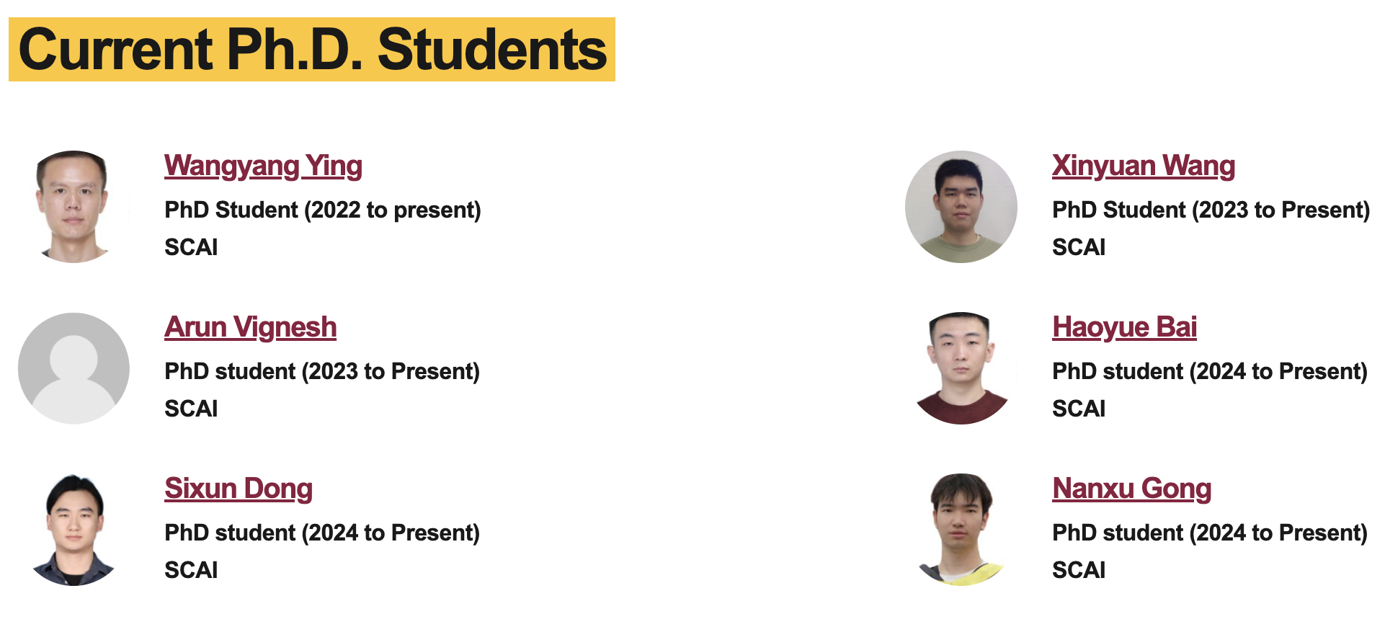
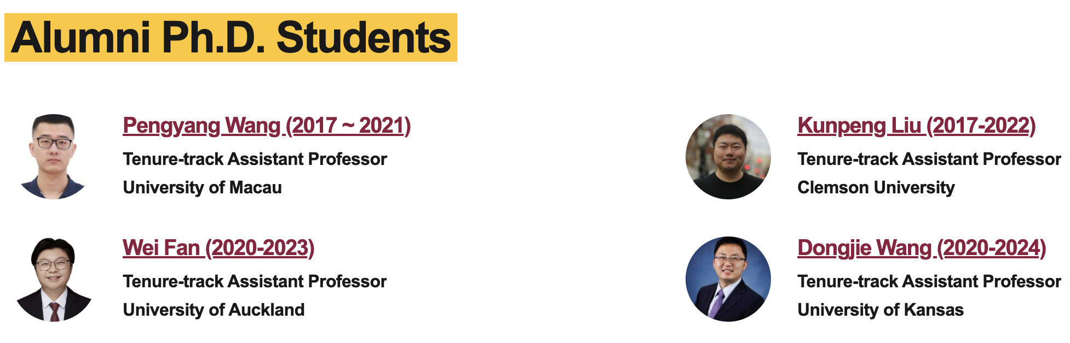
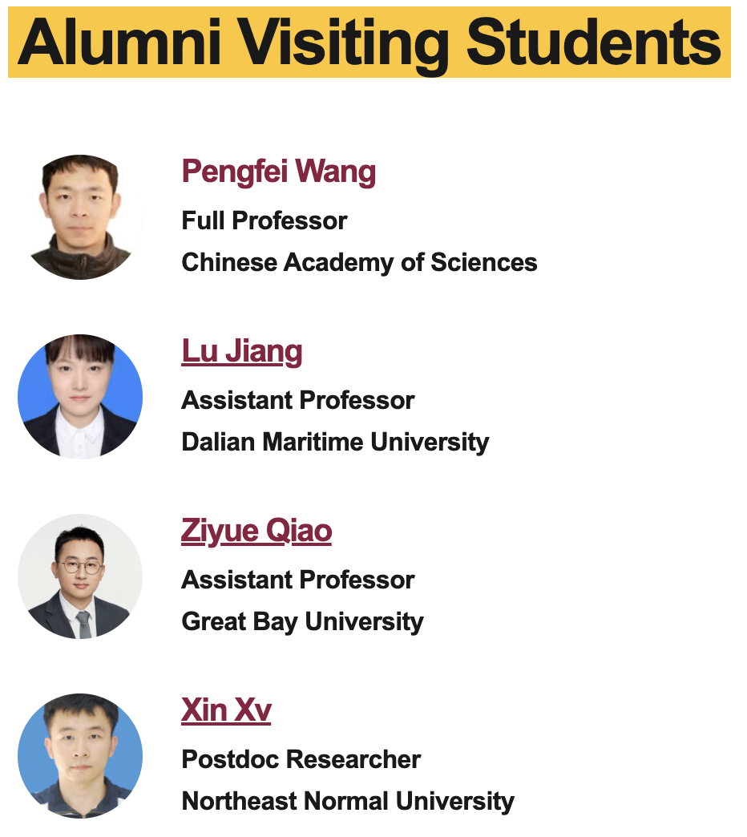
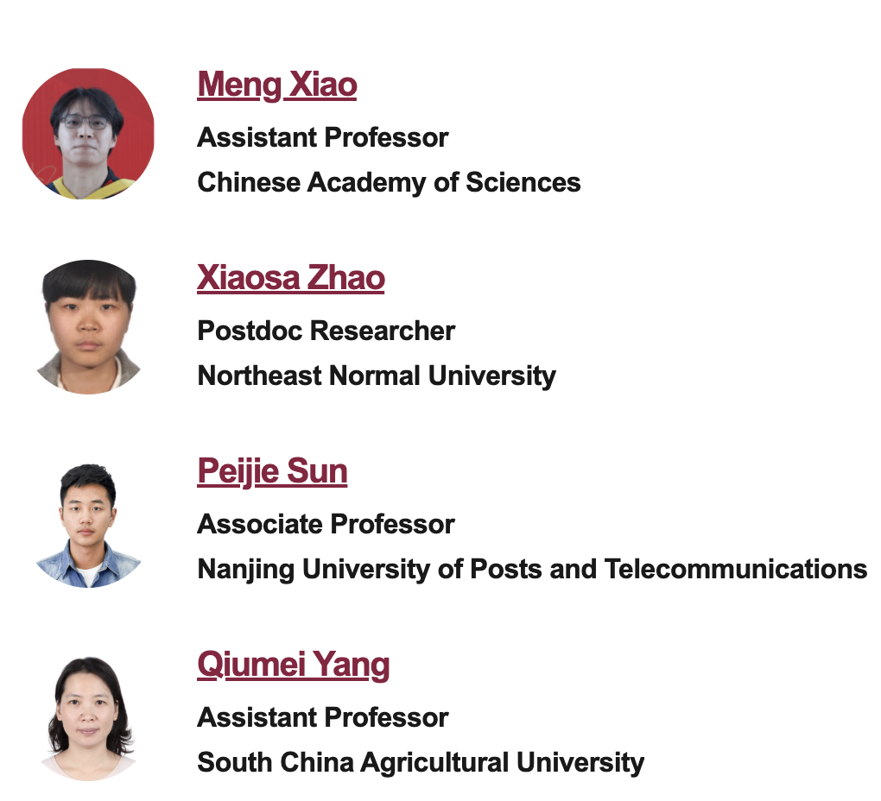
Acknowledgement

Slide 3
Revisiting Data and AI
Data is a knowledge base
AI learns knowledge from data

Slide 4
How Can Data’s Knowledge Influence AI’s Knowledge?
Missing or Incomplete Data
AI Issues Caused:
Poor generalization
Inaccurate predictions
Misleading patterns
Biased Data (Sampling, Label, or Measurement Bias)
AI Issues Caused:
Discrimination or unfairness (e.g., gender/race bias)
Inaccurate models for minority groups
Low trust in AI decisions
High Dimensionality / Curse of Dimensionality
AI Issues Caused:
Overfitting
Computational inefficiency
Irrelevant feature reliance
Imbalanced Classes
AI Issues Caused:
Models ignore minority classes
Low recall/precision for rare classes
Inability to detect rare events
Label Noise or Incorrect Annotations
AI Issues Caused:
Lower model accuracy
Poor convergence
Reinforcement of wrong patterns
Domain or Covariate Shift
AI Issues Caused:
Model fails on new or unseen data
Performance degradation over time or across regions
Poor transfer learning or deployment robustness
Multi-modal Misalignment
AI Issues Caused:
Errors in vision-language or sensor fusion models
Poor embeddings and attention scores
Incoherent outputs
Data Poisoning or Adversarial Data
AI Issues Caused:
Malicious model behavior
Security vulnerabilities
Trust breakdown in mission-critical systems
Notes:
generalization, robustness, overfitting, underfitting, shortcuts, volatility, bias, uncertainty, distribution shift, disorder, mistakes, faults, attacks, or failures

Slide 5
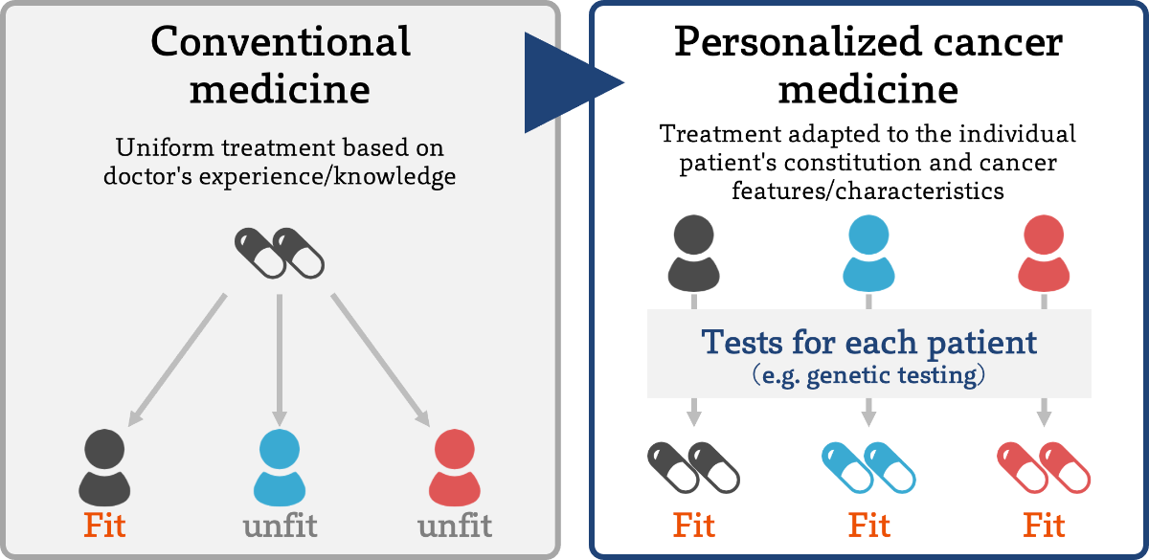
Unified View of Data Issues: Data is Not Always Optimally Structured for An AI Task
Example: personalized/precision cancer treatments
Doctors use a patient’s personalized data (immunization information, medical history, lifestyle factors, specific genetic markers of the patient’s cancer), instead of all patients’ data
Tailor general treatment knowledge to design targeted immunotherapy and reduce side effects
1. Different tasks require task-specific data representation forms.
2. Reprogramming data from a generic form to a task-optimal form is essential for training precise and targeted models.

Slide 6
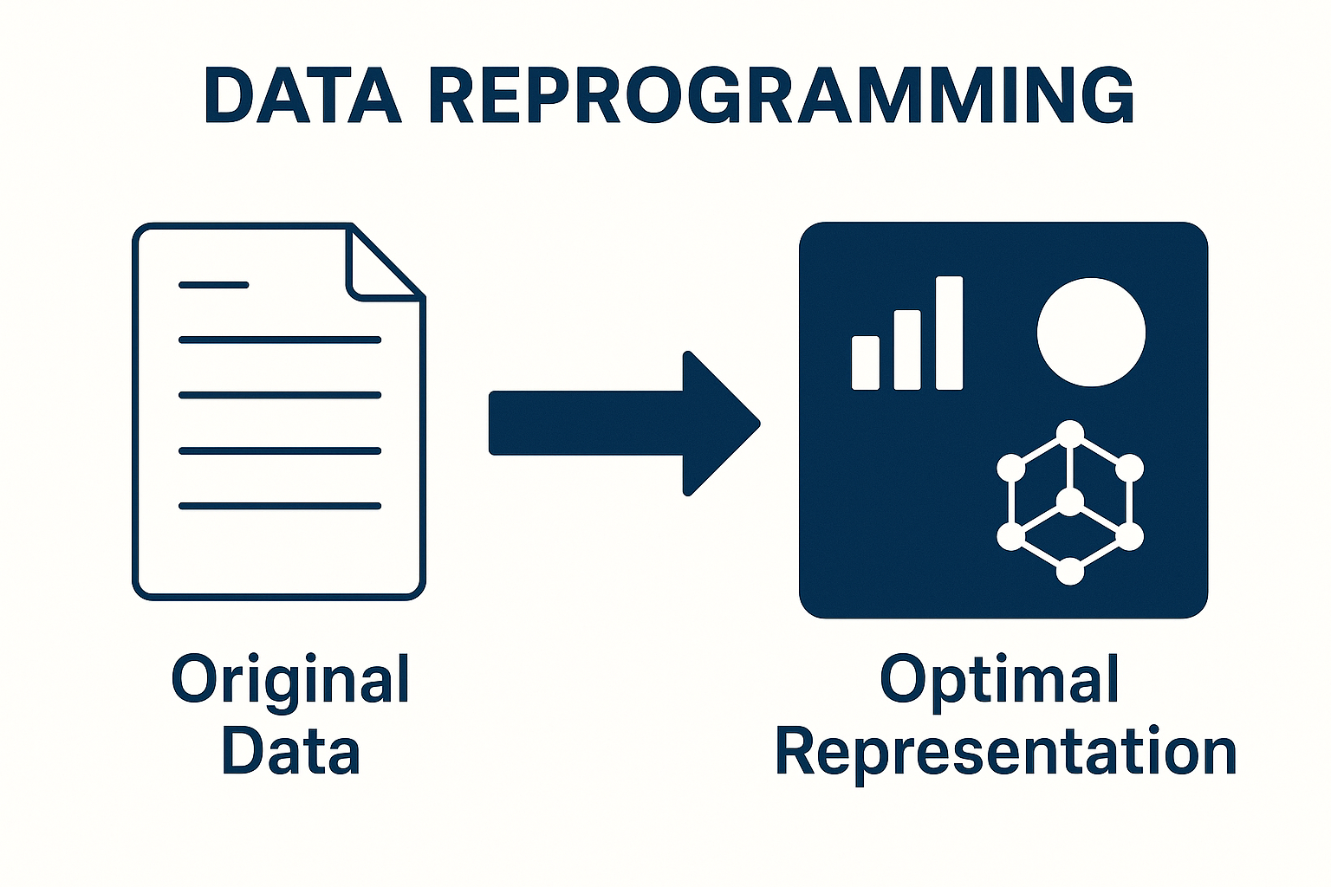
Data Reprogramming: Learning to Reprogram Data Form
Data reprogramming is to reprogram input original data into the optimal knowledge representation/form of output augmented data for a downstream AI task

Slide 7

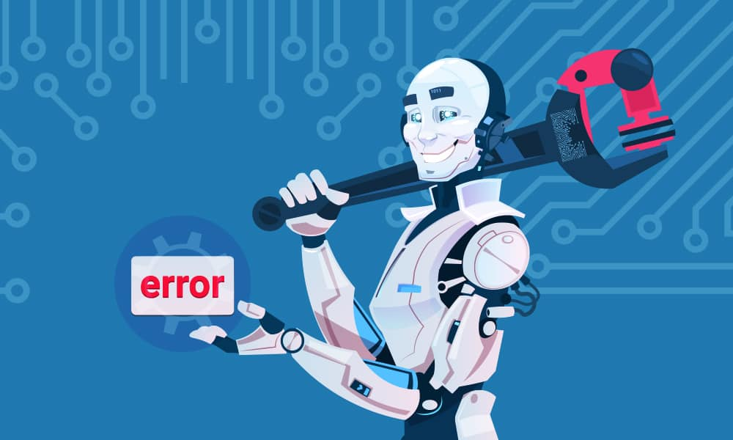
Like Gene Editing: Using AI to Reprogram Data to Edit Model Knowledge to Cure AI Issues
Gene editing to cure genetic diseases: sickle cell disease, Beta-Thalassemia, certain cancers
AI issues: generalization, robustness, overfitting, underfitting, shortcuts, volatility, bias, uncertainty, distribution shift, disorder, mistakes, faults, attacks, or failures

Slide 8
How Can Data Reprogramming Reshape AI?
Gene editing to cure genetic diseases: sickle cell disease, Beta-Thalassemia, certain cancers
AI issues: generalization, robustness, overfitting, underfitting, shortcuts, volatility, bias, uncertainty, distribution shift, disorder, mistakes, faults, attacks, or failures
Using AI to Reprogram Data to Edit Model Knowledge to Cure AI Issues

Slide 9
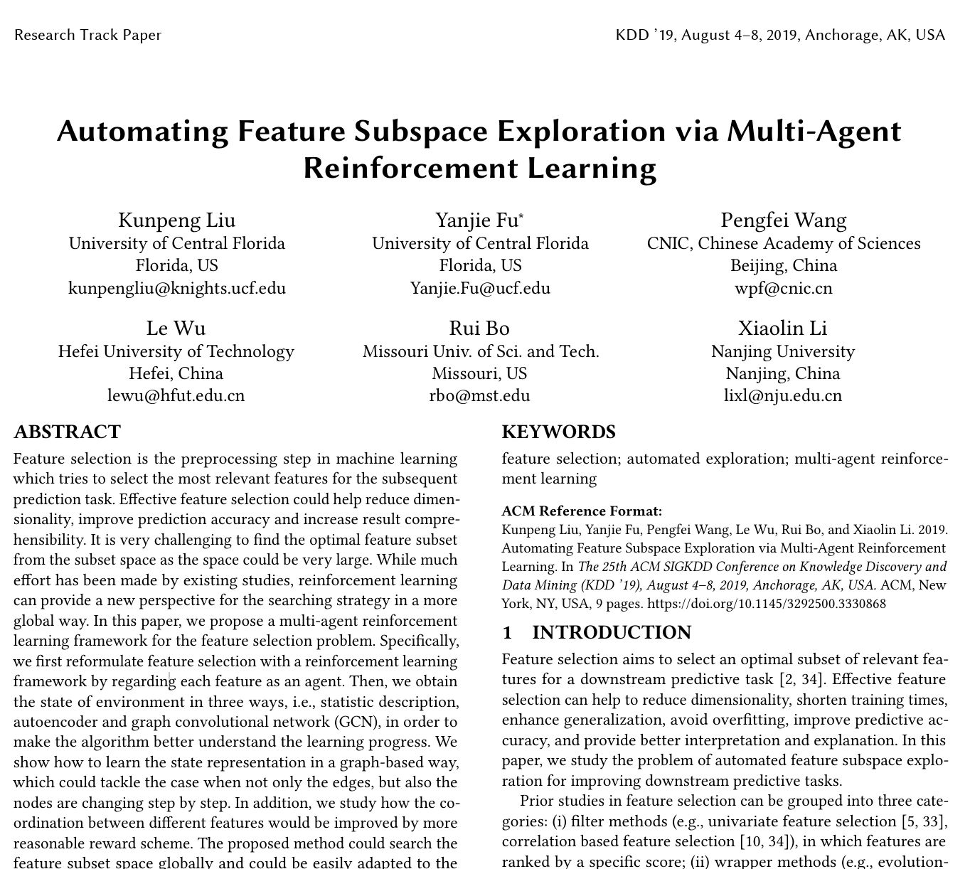
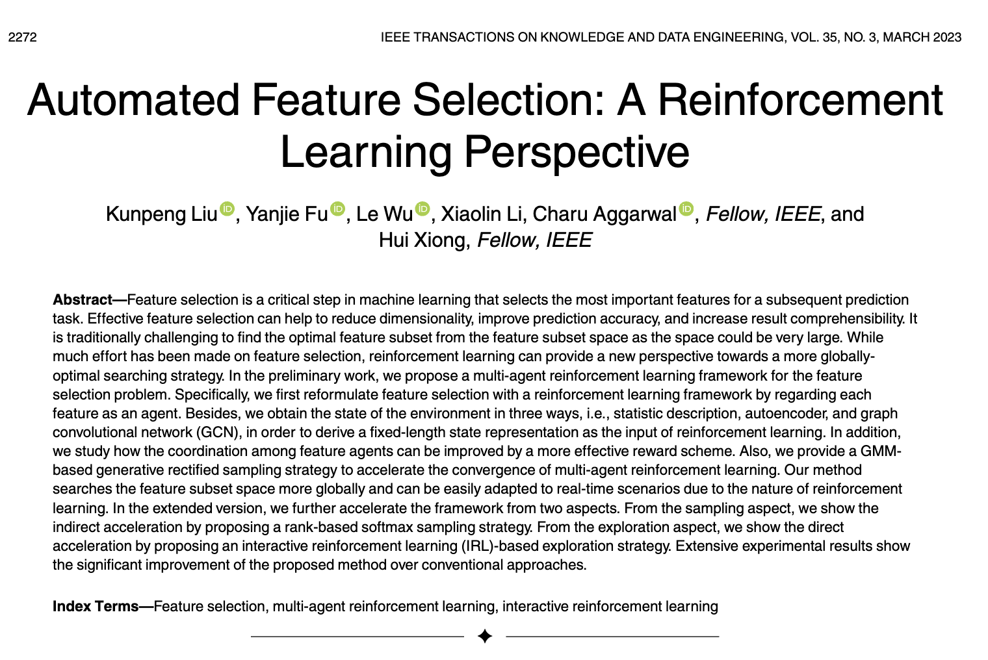
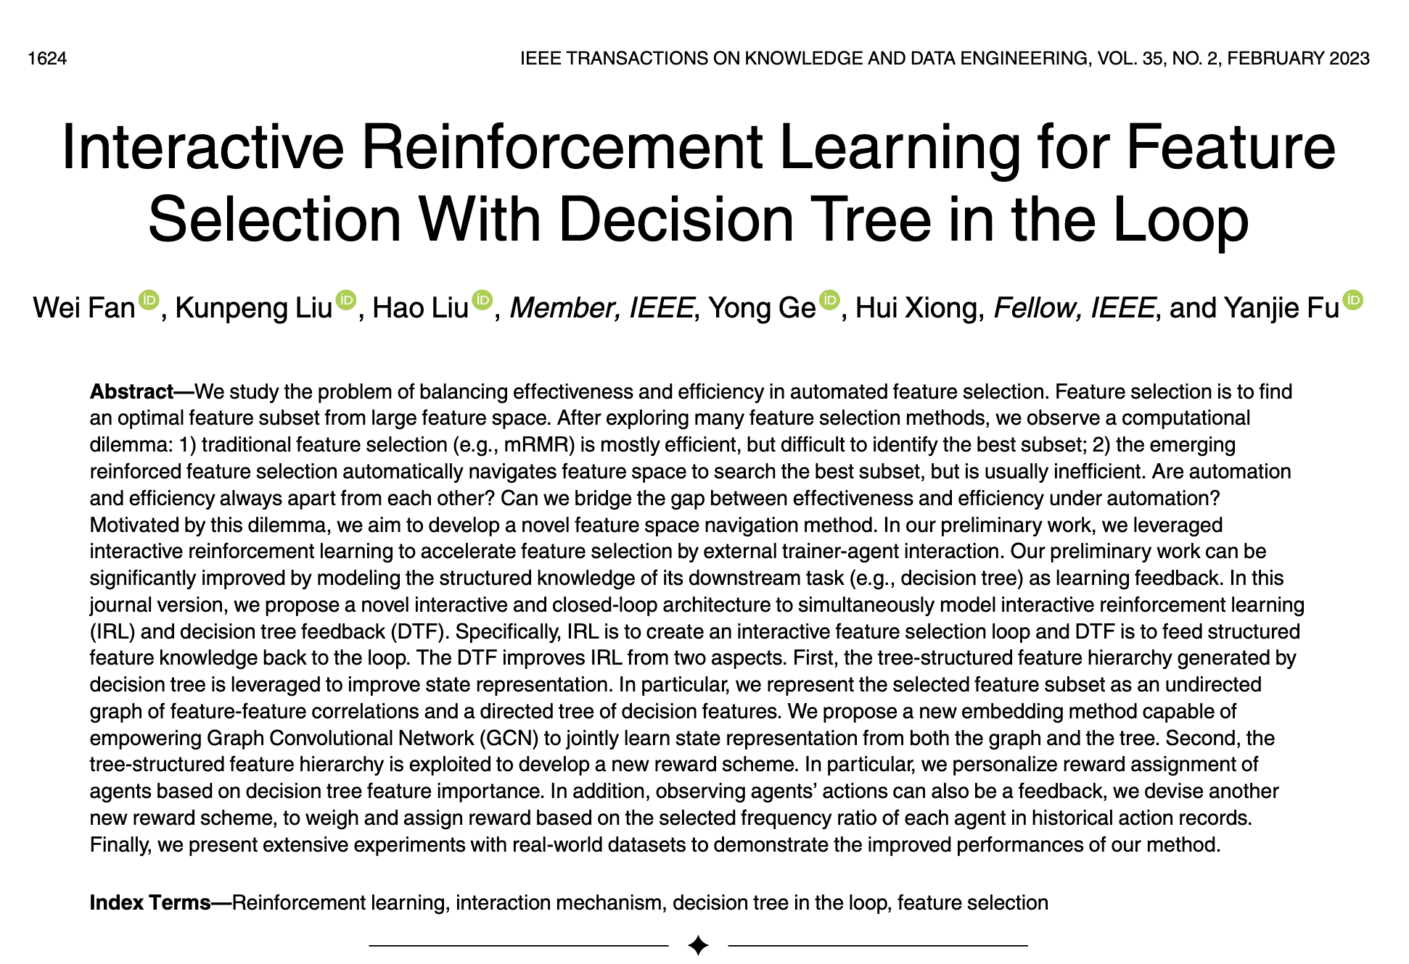
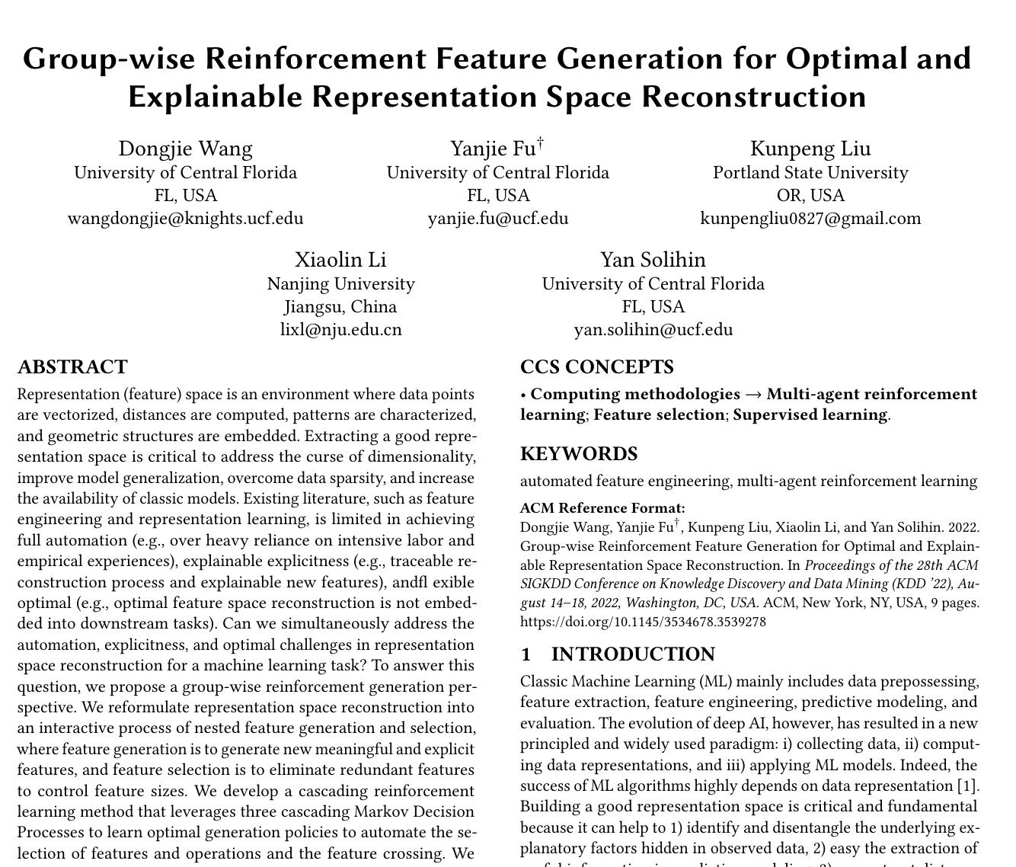
How Can AI to Assist Data Reprogramming (1)
Feature engineering as reinforcement intelligence:
self-optimizing feature selection, transformation, and generation as decision sequences of reinforcement policy networks
Liu, Kunpeng, Yanjie Fu, Le Wu, Xiaolin Li, Charu Aggarwal, and Hui Xiong. "Automated feature selection: A reinforcement learning perspective." IEEE Transactions on Knowledge and Data Engineering 35, no. 3 (2021): 2272-2284.
Fan, Wei, Kunpeng Liu, Hao Liu, Yong Ge, Hui Xiong, and Yanjie Fu. "Interactive reinforcement learning for feature selection with decision tree in the loop." IEEE Transactions on Knowledge and Data Engineering 35, no. 2 (2021): 1624-1636.
Liu, Kunpeng, Pengfei Wang, Dongjie Wang, Wan Du, Dapeng Oliver Wu, and Yanjie Fu. "Efficient reinforced feature selection via early stopping traverse strategy." In 2021 IEEE International Conference on Data Mining (ICDM), pp. 399-408. IEEE, 2021.
Liu, Kunpeng, Yanjie Fu, Pengfei Wang, Le Wu, Rui Bo, and Xiaolin Li. "Automating feature subspace exploration via multi-agent reinforcement learning." In Proceedings of the 25th ACM SIGKDD International Conference on Knowledge Discovery & Data Mining, pp. 207-215. 2019.

Slide 10
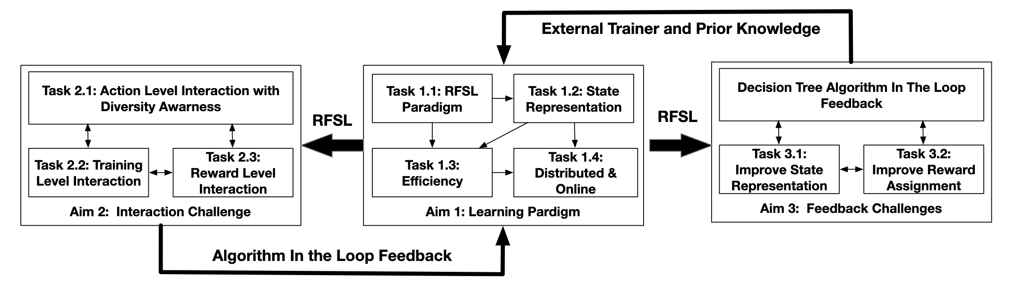

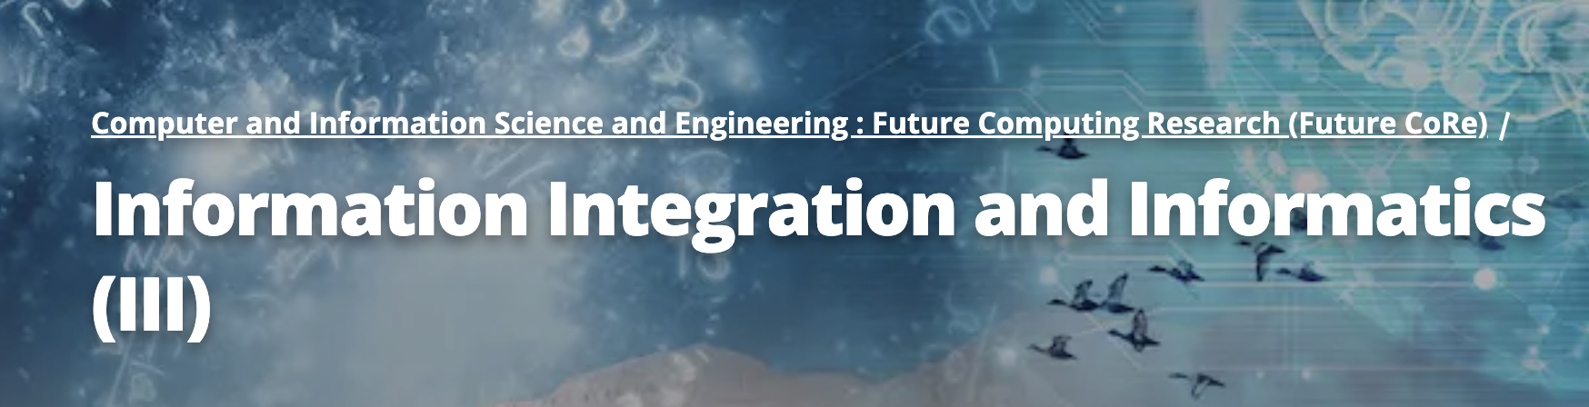
How Can AI to Assist Data Reprogramming (2)
III: Small: Deep Interactive Reinforcement Learning for Self-optimizing Feature Selection (2421803: 2022 to 2025)
Aim 1: Reinforced Feature Selection Learning Framework
Aim 2: Interaction based Knowledge Guidance
Aim 3: Feedback via Algorithm in The Loop
Application: Identification of Representative Molecular Signatures.

Slide 11
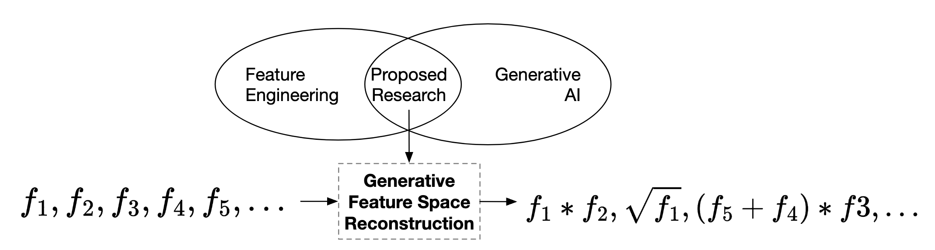
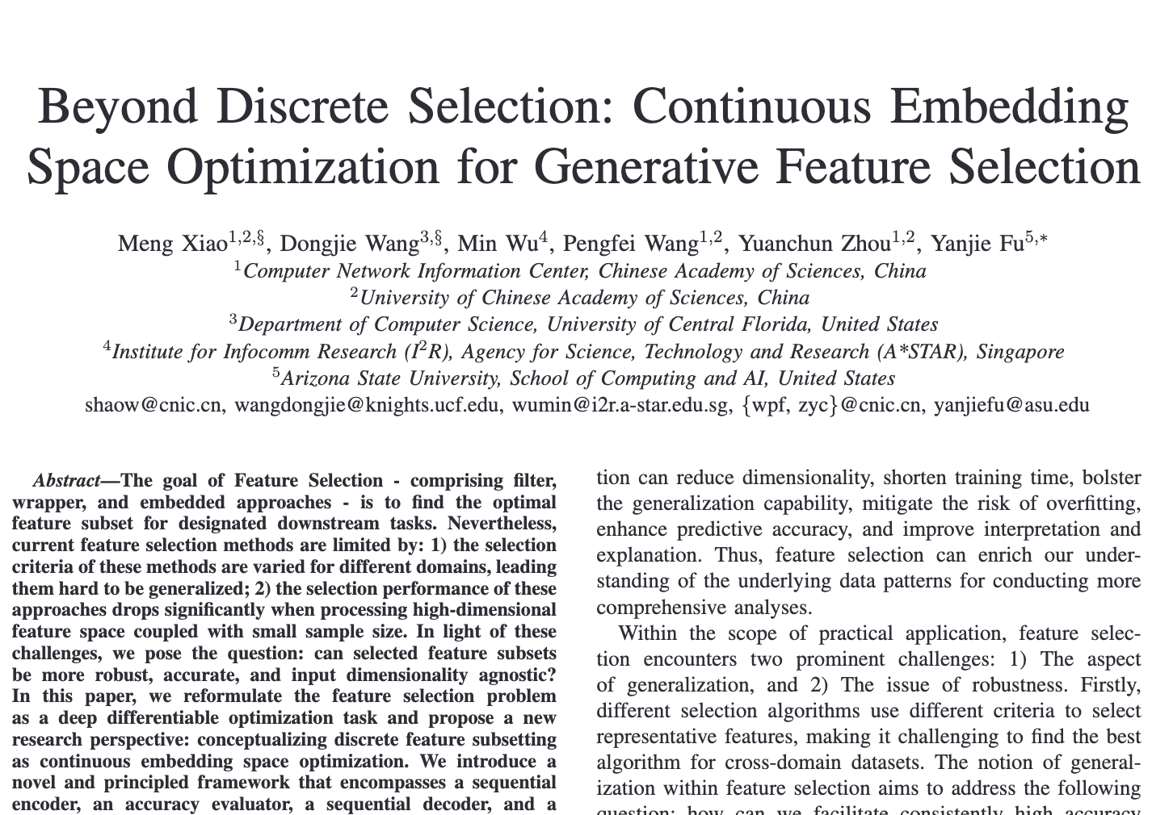
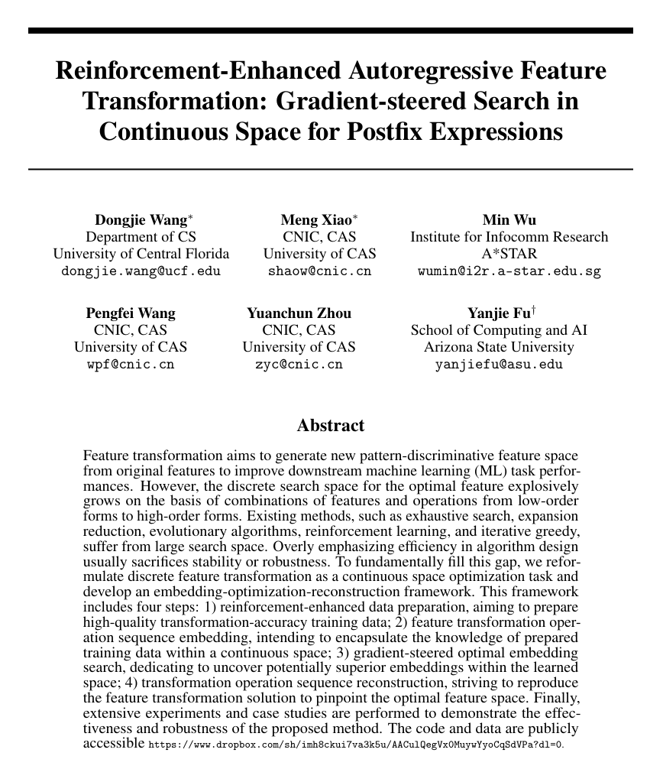
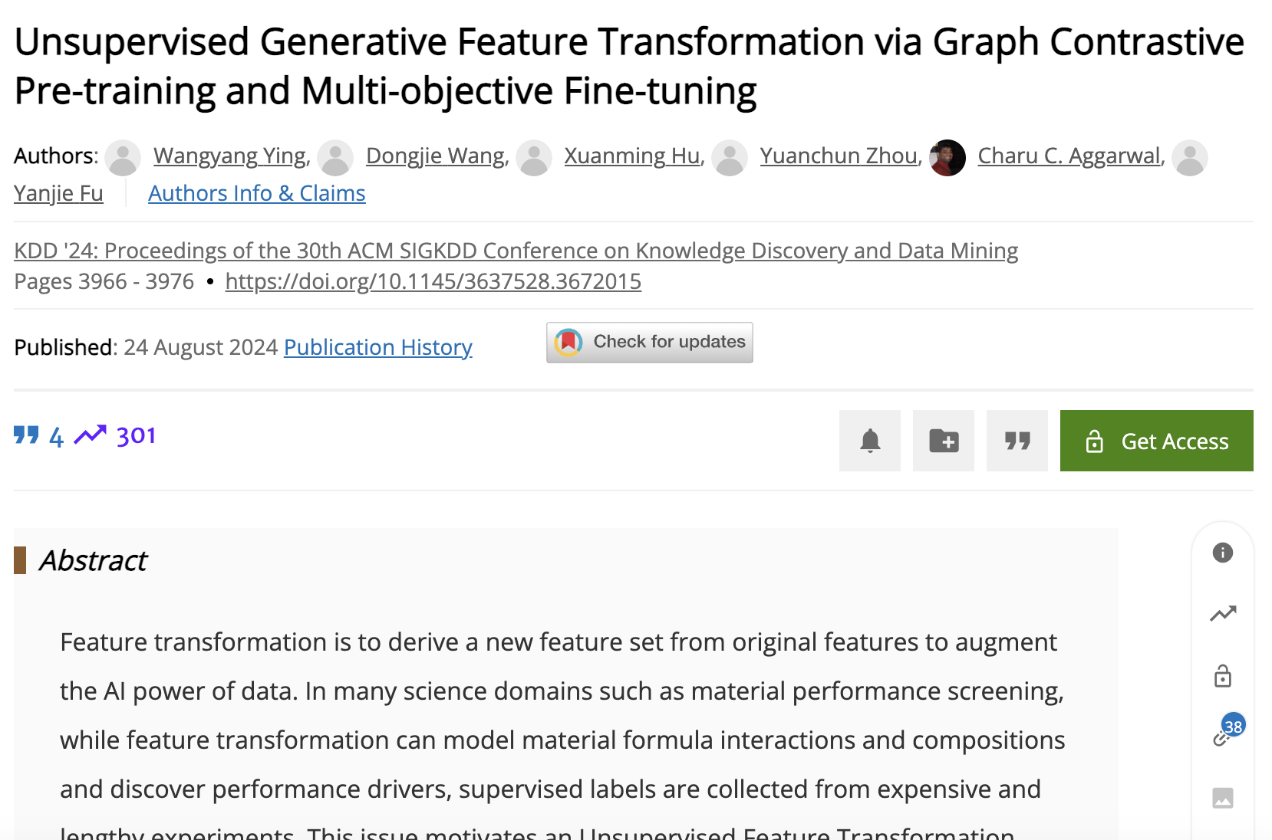
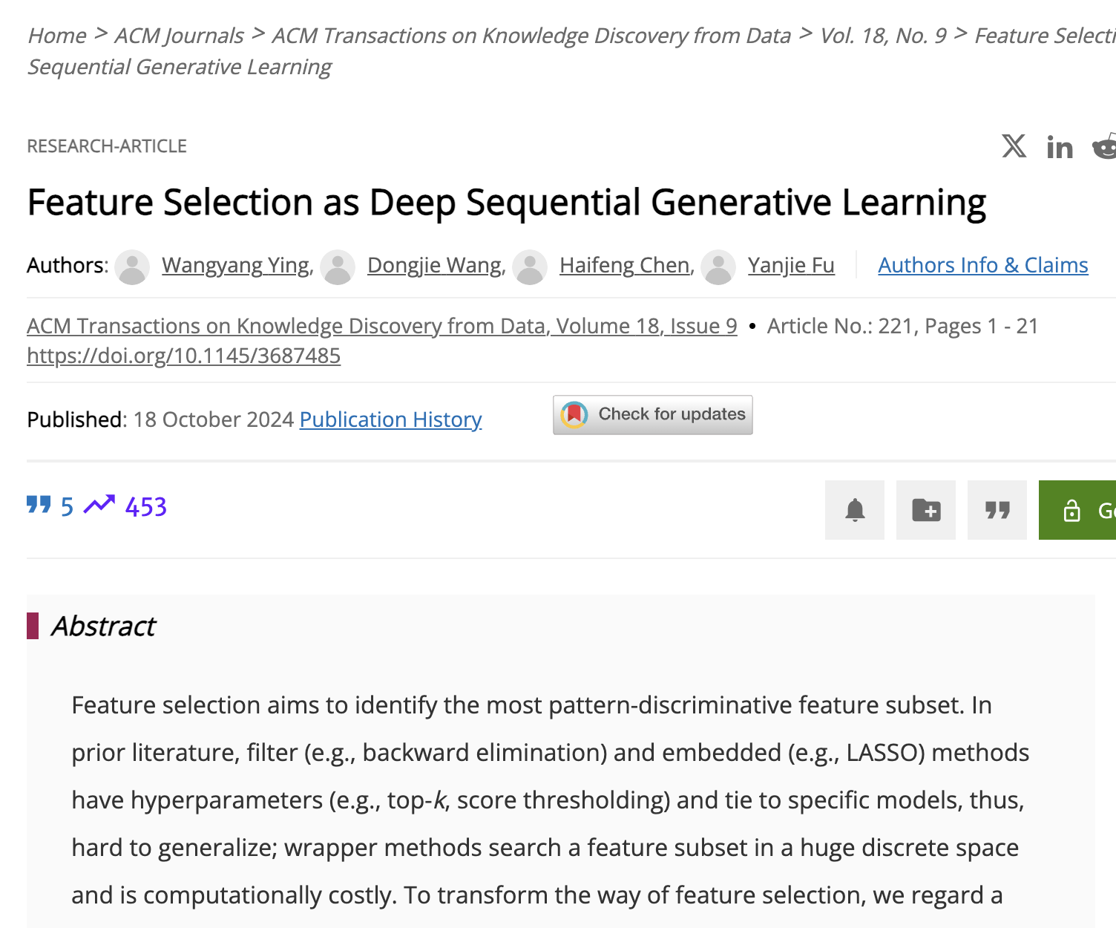
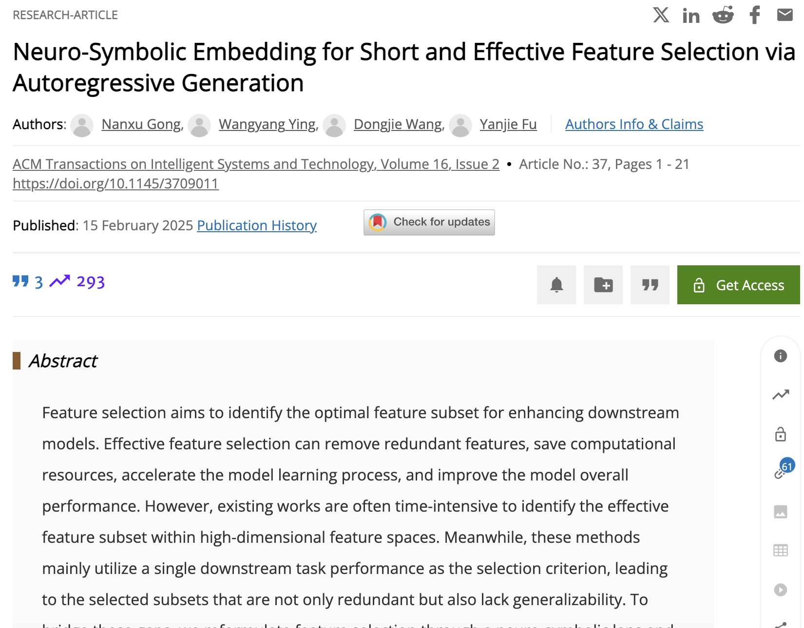
How Can AI to Assist Data Reprogramming (3)
Feature engineering as a generative AI task
Unifying feature selection, transformation, and generation as feature engineering operation tokens to generate
Learning mechanism unknown feature representation space knowledge via generative modeling and continuous latent reasoning for data reprogramming

Slide 12
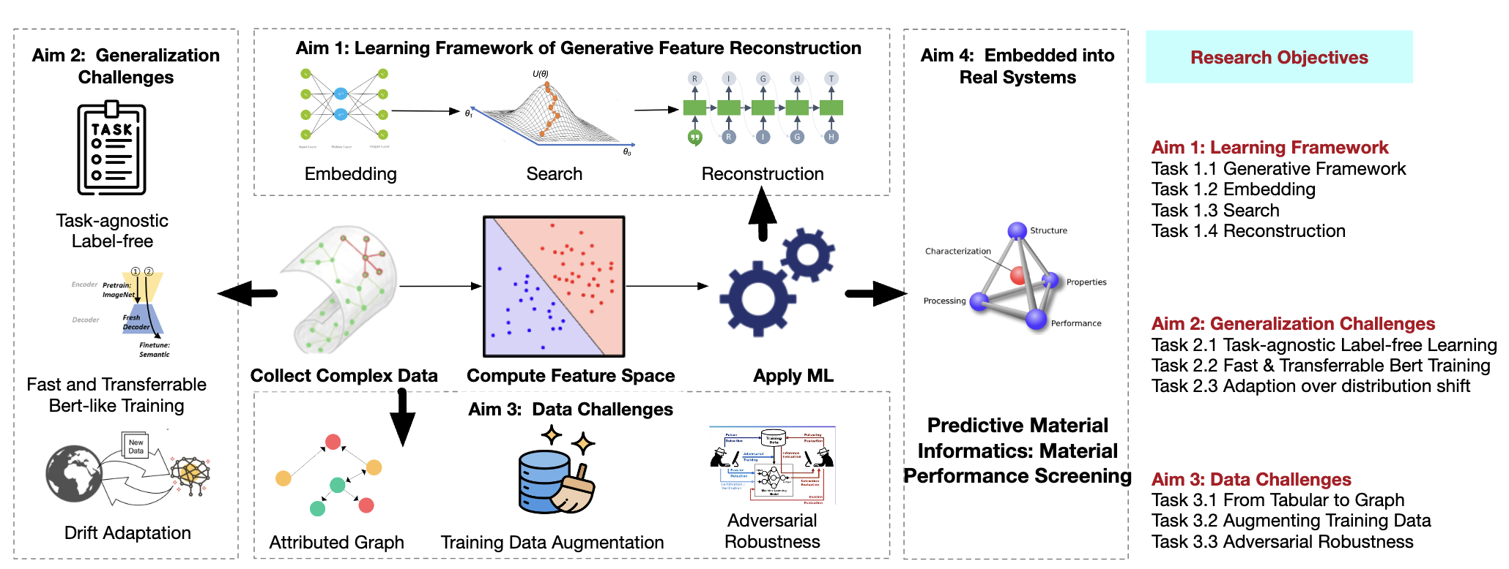
How Can AI to Assist Data Reprogramming (4)
III: Small: Advancing Data-Centric AI through Generative Approaches for Feature Space Reconstruction (2416727: 2024 to 2027)
Aim 1: Proposing the Embedding-Optimization-Generation Framework
Aim 2: Addressing Generalization Challenges
Aim 3: Addressing Data Challenges

Slide 13
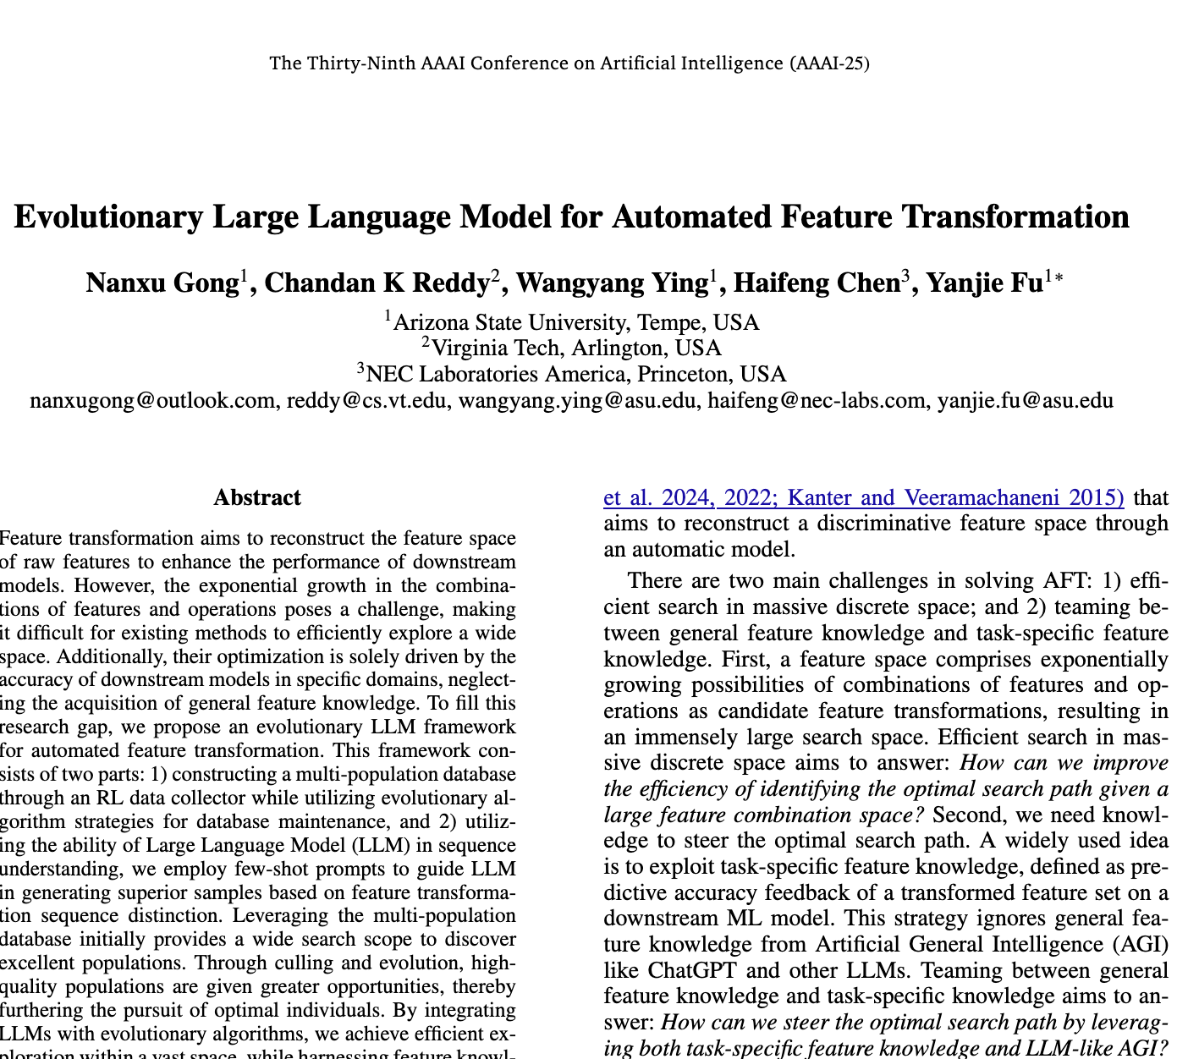
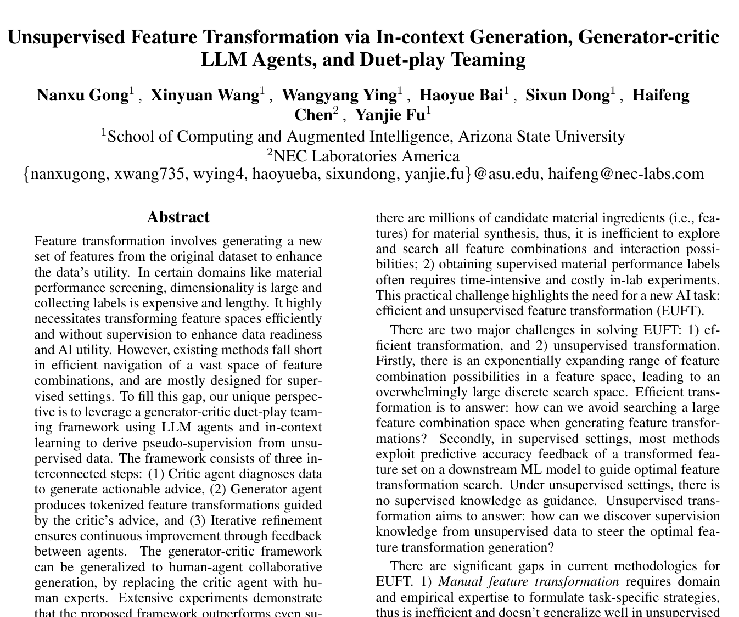
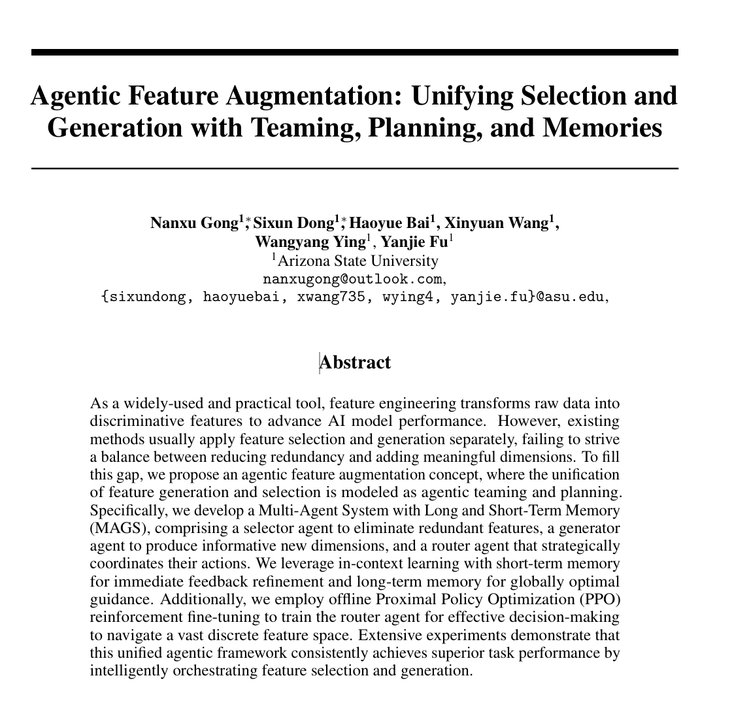
How Can AI to Assist Data Reprogramming (4)
Data reprogramming and QAs, LLMs, reasoning, agentic AI
Data reprogramming as LLM tasking: data perception, data task planning, data action reasoning

Slide 14
A Symbiotic Vision of AI and Data: AI for the Data, AI by the Data, AI beyond the Data
AI for Data Augmentation, Editing, Reprogramming, Repairs
AI
AI For the Data
AI Beyond the Data
AI By the Data
AI to Reason Beyond Data Distribution and Dynamics as Extrapolation Knowledge for Simulation, Planning, World Models
Data’s Structure Knowledge for Guiding AI

Slide 15
Let Us Enjoy The Panel Discussions!
Yanjie Fu
Yanjie.fu@asu.edu
School of Computing and AI
Arizona State University

